Slide 1
Modernizing Applications with Containers

Slide 3
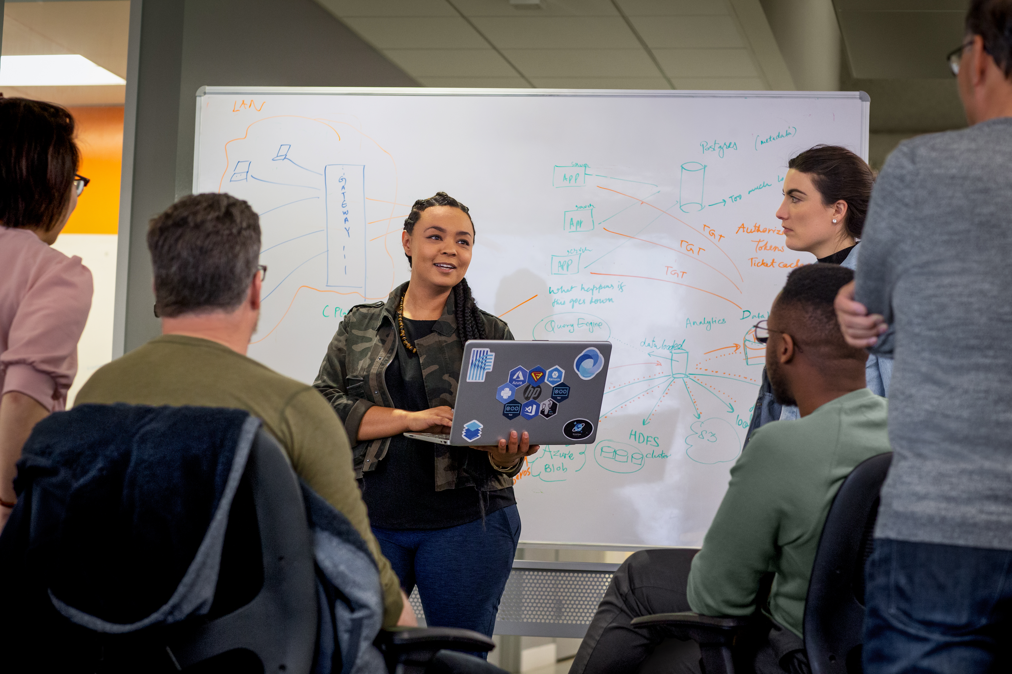
Day 1 Module 1: Introduction to Containers Module 2: Assessing the App and Environment Module 3: Containerizing the App Day 2 Module 4: Preparing for AKS Deployment Day 3 Module 5: Deploying the Application to AKS Module 6: Best Practices and Tips
Agenda

Slide 4
Module 3: Containerizing the App

Slide 5
Module 3: Objectives
Learn Docker Fundamentals (Docker Engine and Client)
Learn How to Build Container Image using Dockerfile
Learn how to Start, Stop, and Remove Docker Containers
Understand use of Tags for Versioning Images

Slide 6
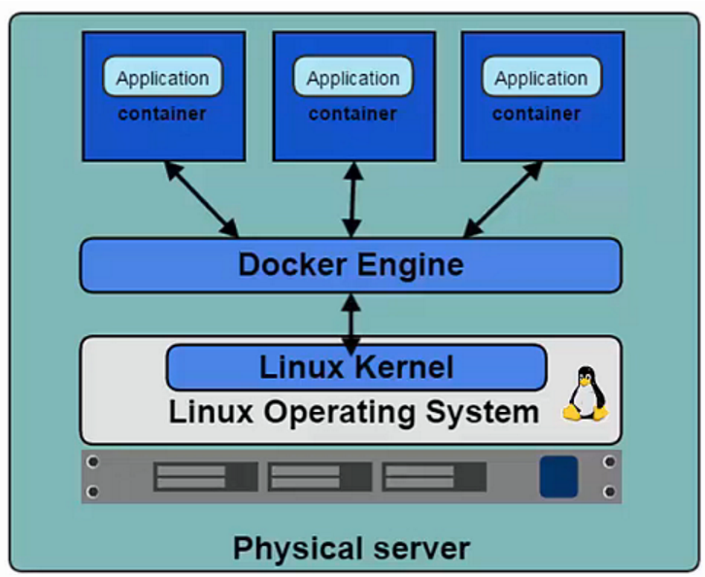
Docker Platform
Docker Engine (a.k.a. Docker Daemon)
Software that enables containers to be built, shipped, and run.
Uses Linux Kernel namespaces and control groups to give an isolated runtime environment for each application.
Docker Hub
An online registry of Docker images.
Docker Trusted Registry
Private on-site Registry for Docker images.
Docker can run on most platforms, including:
Windows 11, MacOS, and Linux desktop platforms.
Bare metal and virtual machine images in on-premise environments.
Cloud compute and serverless platforms.
Notes:
Let’s describe Docker platform:
Docker => industry standard
Engine ⬄ Daemon => runtime to run & manage container.
=> interact with the Linux Kernel
But you Cannot containerize everything -> example: usage of kernel related features (Windows registries).
Initially based on Linux OS with OS specific components (namespace, control group for isolation) => release in Dec 2013
Docker Hub => store your images online
Docker trusted registry => implement Docker Hub on premises

Slide 7
Docker Platform (cont.)
Docker Client
Takes user inputs and sends them to the Daemon.
Client and Daemon can run on the same host or on different hosts.
Dockerfile
A simple text file that consists of instructions on how to build a Docker image.
Docker Images
Read-only template used to create containers.
Contains a set of instructions for creating the containers.
Docker Containers
Isolated application platform based on one or more images.
Contains everything needed to run your application.
Host
Container 1
Container 2
Docker Client
Container 3
docker push
docker pull
Container …
docker run
docker …
Docker Daemon
Notes:
Docker client => CLI -> commands to interact with the daemon
Docker Images => definition of your container => list dependencies, how to install / them set them up.
Docker container => image instance. Snapshot of your image available to be run.

Slide 8
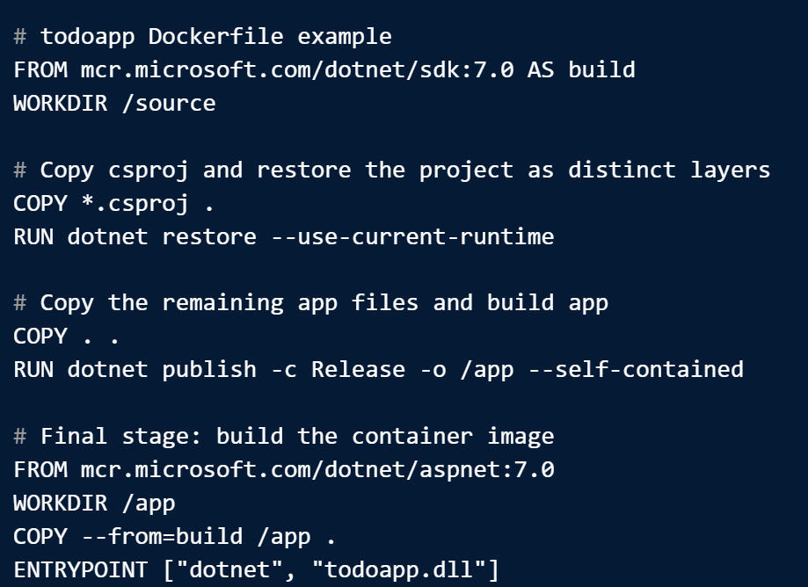
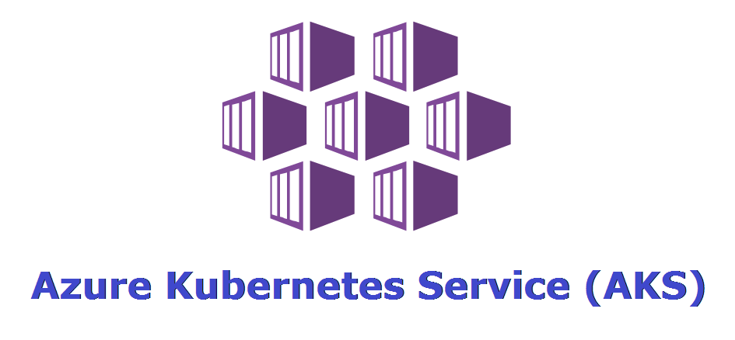
Docker Image Lifecycle
docker build
docker run
docker push
docker pull
Workstation
Docker Container
Dockerfile
Staging
Docker Image
Container Registry
Docker Client
Git Repo
Production
Docker client downloads app repo and uses the Dockerfile to build the container image with the app and all dependencies.
Docker client pushes the container image to a local registry.
The container image is used to launch the app container locally for testing.
Docker client pushes the container image to a remote registry.
AKS pulls container image down from a remote registry to deploy the image into one or more containers.

Slide 9
Dockerfile
A Dockerfile is a simple text file that consists of instructions to build a Docker image
A Dockerfile has some rules and formats:
The file name must be Dockerfile with no extension.
The first line must tell Docker what base image to use, such as ubuntu:18.04 or python:3.8-slim-buster. A base image is like a ready-made cake mix you can customize with your own ingredients.
The rest of the lines must tell Docker what commands to run, what files to copy, what ports to expose, etc. Each line creates a new layer in the image. A layer is like a thin slice of cake that you can stack on top of each other.
.NET Project Structure
- containers-workshop
- todoapp
- Controllers
- Data
- Models
- Properties
- Views
- wwwroot
- .gitignore
- CONTRIBUTING.md
- LICENSE
- LICENSE.md
- README.md
Example Dockerfile
# todoapp Dockerfile example
FROM mcr.microsoft.com/dotnet/sdk:7.0 AS build
WORKDIR /source
# Copy csproj and restore the project as distinct layers
COPY *.csproj .
RUN dotnet restore --use-current-runtime
# Copy the remaining app files and build app
COPY . .
RUN dotnet publish -c Release -o /app --self-contained
# Final stage: build the container image
FROM mcr.microsoft.com/dotnet/aspnet:7.0
WORKDIR /app
COPY --from=build /app .
ENTRYPOINT ["dotnet", "todoapp.dll"]

Slide 10
Docker Compose
Compose is a tool for defining and running multi-container Docker applications.
Uses a YAML file to configure your application services.
Has commands for managing the whole lifecycle of your application:
Start, stop, and rebuild services
View the status of running services
Stream the log output of running services
Run a one-off command on a service
The features of Compose that make it effective are:
Multiple isolated environments on a single host
Preserves volume data when containers are created
Only recreate containers that have changed
Supports variables and moving a composition between environments
Example docker-compose.yaml
services:
web:
build: .
ports:
- "8000:5000"
redis:
image: "redis:alpine"

Slide 11
Container Image Tagging
Docker Image tags are simple labels or aliases given to a docker image before or after building an image to describe a particular image.
The format of a container image file name is: <image−name>:<tag−name>
Examples: todoapp:v1.01, wordpress:latest
Tags are added to images using the docker tag command. Tags can also be attached when you’re building an image with docker build by passing the -t flag.
The tag command takes two arguments: an existing tag identifying an image and a new “target” tag to assign to that image:
docker tag example-image:1.1.0 example-image:1.1.0-apache
When you pull a “bare” image without a tag, such as docker pull example-image, Docker implicitly uses latest.

Slide 12
Module 3: Demonstration
Build Docker Image
Run Docker Image Locally
Push the Docker Image to Remote Registry

Slide 13
Module 3: Lab Containerize the App
Create an Azure SQL Database
Modify app settings to use the database
Build Todo App Docker Image
Run Todo App Docker Image Locally

Slide 14
Instructions for Completing Module 3: Lab
Time: 45 minutes
Steps:
Navigate to your local git repo that you checked out earlier.
Copy the app project directory .\App\Starter\todoapp to .\App\Working\todoapp
Complete lab using the lab guide called Module 3 - Demo Building and Testing a Container Locally.

